Slide 1
Intrusion Detection System for Wireless Sensor
Networks: A Machine Learning
Based Approach
19L015 - WIRELESS SENSOR NETWORKS
ASSIGMENT PRESENTATION
BY:
HARI KHISSAN B(22L219)
RAGHAVAN S U(22L255)

Slide 2
INTRODUCTION
• Wireless Sensor Networks (WSNs) are widely used in critical applications such as healthcare monitoring, smart cities, and IoT systems.
• These networks are highly vulnerable to cyber-attacks including flooding, impersonation, and injection attacks.
• Traditional security mechanisms fail due to high-dimensional data and class imbalance.
• Intrusion Detection Systems (IDS) are required to efficiently detect malicious traffic in real-time.

Slide 3
NEED FOR THE WORK
There is a growing need to secure wireless sensor networks because cyber-attacks are increasing.
Existing systemms have problems like:
Low accuracy
High false alarms
Poor handling of large data
Our goal is to build a syste that is more accurate, efficient, and scalable for real-time use.

Slide 4
PROBLEM STATEMENT
The core challenge in securing these networks is the need for real-time, high-accuracy detection within fast-paced, resource-constrained environments. Current Intrusion Detection Systems (IDS) often struggle with the following technical bottlenecks:
Data Complexity and Redundancy: WSNs generate large volumes of high-dimensional data containing redundant features that do not contribute to effective classification.
Computational Inefficiency: Processing these massive datasets results in time-consuming training phases, which is impractical for immediate intervention in IoT settings.
Operational Reliability: Existing models frequently fail to balance a high detection rate with a low false alarm rate, leading to either missed threats or unnecessary disruptions to legitimate network operations.
Consequently, there is a critical need for an optimized framework that utilizes advanced feature engineering and efficient machine learning architectures to provide robust, plug-and-play security for the evolving IoT landscape.

Slide 5
OBJECTIVES
Threat Protection: To develop a sophisticated Network Intrusion Detection System (NIDS) specifically designed to safeguard Wi-Fi-based Wireless Sensor Networks (WSNs) from impersonation, flooding, and injection attacks.
Technical Optimization: To implement a meticulous feature selection process that reduces the initial 154 features down to 13 pivotal indicators, ensuring efficient and focused data analysis.
Performance Enhancement: To achieve high detection accuracy while simultaneously reducing loss values and minimizing the False Alarm Rate (FAR).
Model Evaluation: To propose and train a XGBoost with SMOTE for optimal multiclass classification and check its efficiency.

Slide 6
METHODOLOGY
1. Data Pre-processing & Engineering
Feature Selection: Reduced 154 raw WiFi characteristics to 13 core behavioral features to optimize for real-time edge performance.
Cleaning & Normalization: Standardized 1.7M training samples using StandardScaler (Mean=0, Std=1) to ensure uniform feature importance.
Class Balancing (SMOTE): Addressed the data imbalance by generating synthetic minority samples, preventing "majority-class bias".
2. Training Architecture
Model Selection: Utilized XGBoost (Extreme Gradient Boosting) for its superior handling of tabular data compared to traditional Deep Learning.
Configuration: 150 decision trees with a maximum depth of 10 to balance high accuracy with model generalization.
Execution: Leveraged GPU-accelerated histogram construction for rapid training and millisecond-level inference.
3. Validation Framework
Dataset Split: 80/20 Stratified Split (1.43M training / 359K testing) to preserve real-world attack distributions.
Success Metrics: Prioritized Attack Recall and F1-Score to ensure a "Zero Missed Threat" security posture.

Slide 7
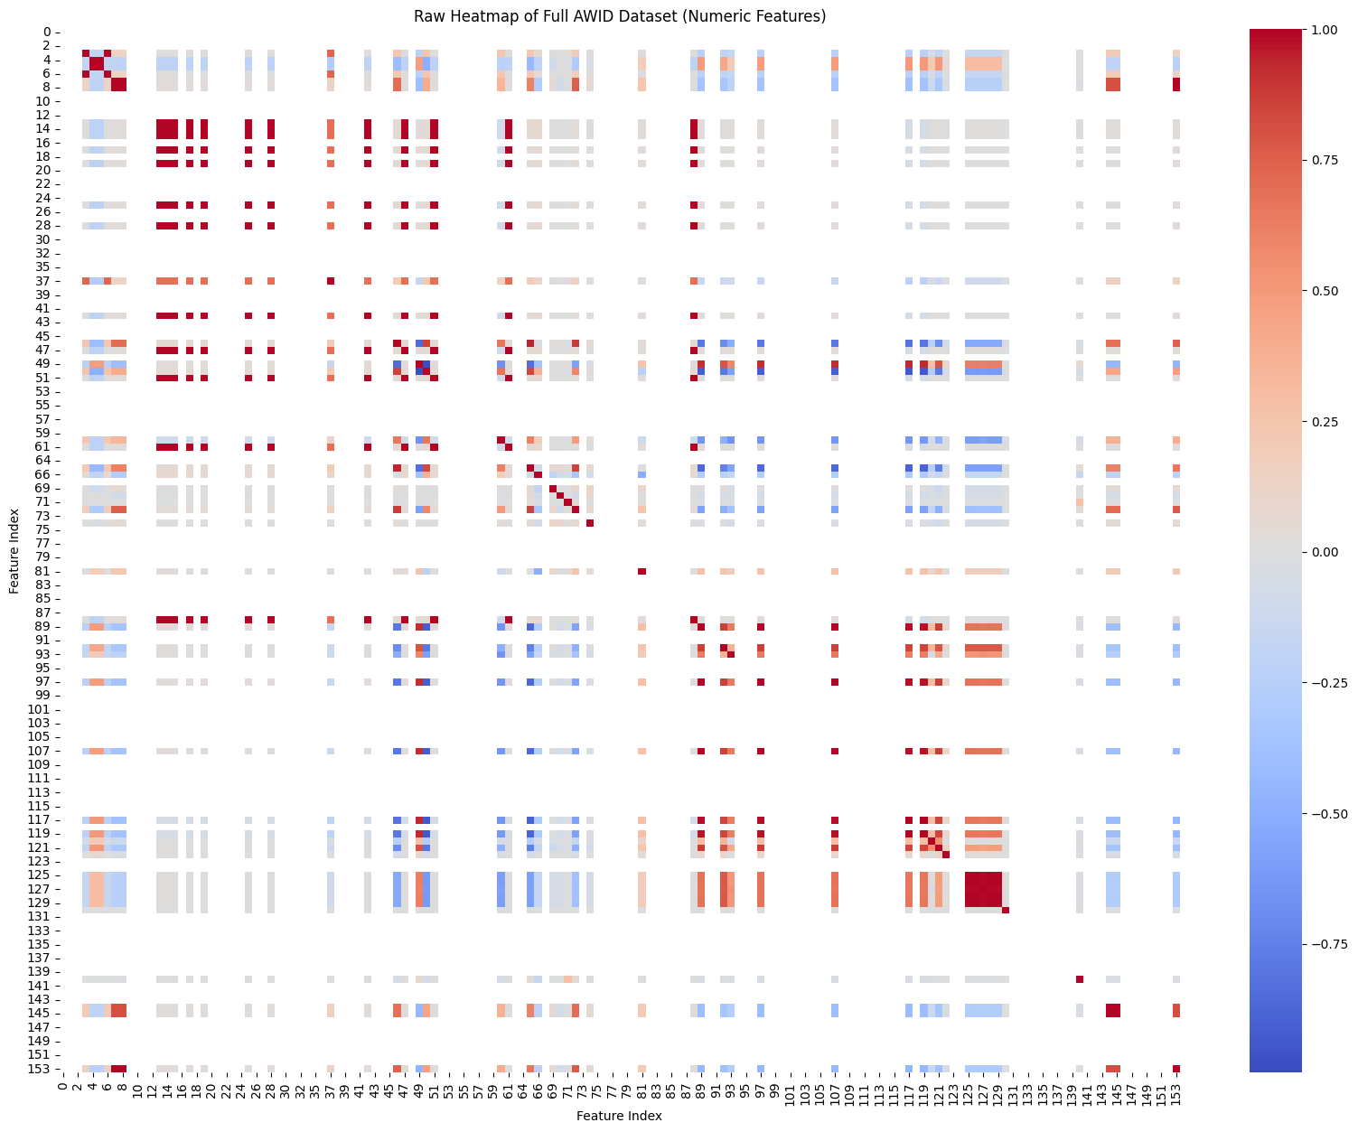
DATASET
• To utilize the AWID (Aegean Wi-Fi Intrusion Detection) dataset for training and testing the IDS model.
• To work with real-world Wi-Fi network traffic data consisting of large-scale samples. Total Samples: 1.7 million WiFi packets
• To consider 154 original features and reduce them to optimized feature sets.
• To classify data into four categories: normal, flooding, injection, and impersonation.AWID Dataset (Aegean WiFi Intrusion Detection)
Normal (86%), Flooding (2.7%), Injection (3.6%), Impersonation (2.7%)
Test Set: 359,115 samples
Notes:
How to Describe it Professionally
If you are explaining this slide to an audience, here are two ways to phrase it depending on what the heatmap represents:
1. If it represents Feature Correlation:
"The scale from 0 to 1 represents the Pearson Correlation Coefficient. A value of 1 indicates that two WiFi features are perfectly correlated. We used this to identify and eliminate redundant data, allowing us to focus on the 13 most pivotal behavioral features."
2. If it represents Normalized Data (Intensity):
"The 0 to 1 scale represents the Standardized Feature Range. Since we applied a StandardScaler, all raw WiFi packet values—like frame length or sequence numbers—were normalized to this range so the model treats every feature with equal importance during training."

Slide 8
DATASET
13 behavioral features
Behavioural 13 Features:
├─ Frame Structure: frame_len, rt_len, rt_tsft, rt_flags
├─ WiFi Control: fc_type, fc_subtype, fc_retry
├─ Sequence Data: wlan_seq, data_len
├─ Management: mgt_privacy, mgt_beacon
└─ Quality of Service: qos_tid, qos_priority
1
76 selected features
2
154 original features
3

Slide 9
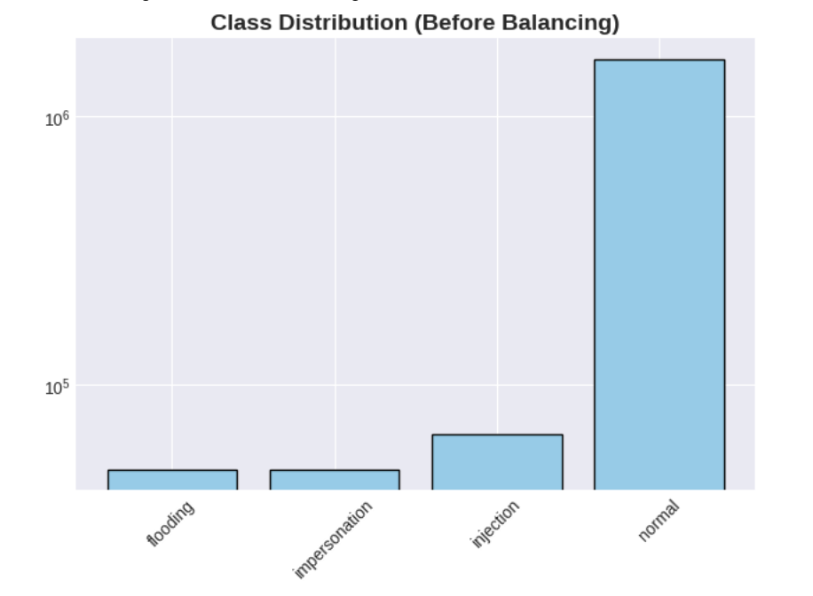
WORK DONE
Initial Distribution Analysis
1. High Feature Selection: Extracted 13 critical behavioral indicators (e.g., frame_len, wlan_seq, qos_priority) from the AWID-CLS-R dataset.
2. Non-Ordinal Categorical Encoding: Implemented One-Hot Encoding (OHE) for fc_type and fc_subtype. This prevents the XGBoost algorithm from assuming a false mathematical hierarchy between different Wi-Fi frame types.
3. The Class Imbalance : Quantitative analysis reveals a severe 91.0% skew toward "Normal" traffic. This creates a "Majority Bias" where a model could achieve high global accuracy while failing to detect 100% of actual network intrusions.
Number of Samples (Packet Count)
Attack Vector (Class Type)

Slide 10

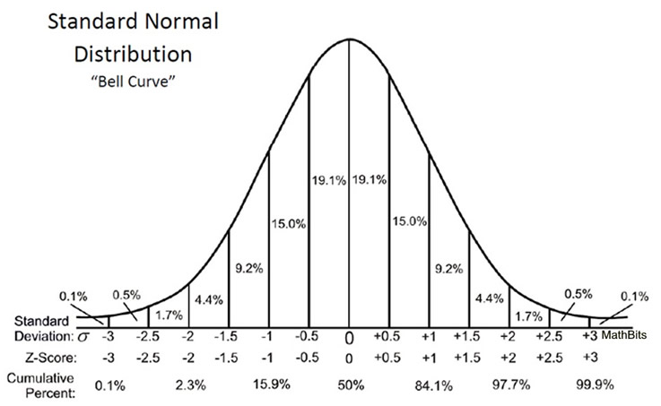
Initial Distribution Analysis
4. Z-Score Feature Standardization: Applied StandardScaler to normalize feature scales, ensuring the gradient-based optimizer remains stable and converges faster by centering data around a zero mean with unit variance:
Example
x=1500 bytes.
μ= 600 bytes.
σ =300 bytes.
Substituting the value : z = 3.0
x(Observed Value): The raw feature value of the specific network packet currently being analyzed
μ (Baseline Mean): The calculated mathematical average of that specific feature across the entire training dataset.
σ(Feature Volatility): The Standard Deviation, representing the typical "spread" or dispersion of values around the average.
Notes:
1. Unit Neutrality (The "Apples to Oranges" Problem)
Your dataset contains features with completely different scales:
frame_len: Can be 1,500+ (Bytes).
qos_priority: Only goes from 0 to 7 (Categories).
If you don't use Z-values, the XGBoost algorithm might assume frame_len is 200 times more important simply because the numbers are larger. The Z-value strips away the units and turns everything into "Standard Deviations," making the comparison fair.
2. Accelerating Gradient Convergence
XGBoost is a gradient-based optimization algorithm. It searches for the "minimum error" in a multi-dimensional landscape.
Unscaled Data: The landscape is stretched and distorted (like a long, skinny valley), making it hard for the model to find the bottom.
Z-Scaled Data: The landscape becomes a perfect "bowl." This allows the model to find the most accurate solution much faster and with fewer errors.

Slide 11
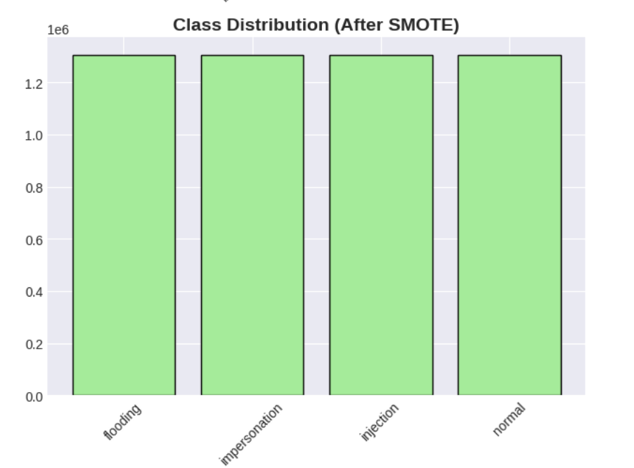
Synthetic Minority Over-sampling Technique (SMOTE)
The Problem: Majority class (Normal traffic) creates a "Self-Accuracy Trap" where the model ignores rare attack vectors.
The Solution: SMOTE with k=1 (Nearest selection)
Create synthetic sample: x_new = x_i + λ × (x_j - x_i)
x_i : The original packet.
x_zi : A neighbor packet of the same type found nearby in the data.
(x_j - x_i) : The distance between them.
λ: The "Random Step." It determines exactly where on the line between the two real packets the new "fake" packet will be born.
Original minority samples: ● ● ●
│ │ │
Synthetic samples: ○─○─○ ○─○─○ ○─○─○
Number of Samples (Packet Count)
Attack Vector (Class Type)

Slide 12
Model Suitability
Feature | XGBoost (Ensemble Trees) | DNN (Deep Neural) | CNN (Convolutional) | RNN / LSTM (Recurrent)
Data Topology | Structured Tabular | Continuous Manifolds | Spatial/Grid Patterns | Temporal Sequences
Mathematical Logic | Recursive Partitioning | Stochastic Gradient Descent | Feature Map Extraction | Hidden State Memory
Interpretability | High (Feature Gain/Weight) | Low (Black Box) | Low (Latent Space) | Low (Temporal Weights)
Sparsity Handling | Native Sparsity-Aware | Poor (Requires Dense Inputs) | Poor (Requires Padding) | Poor (Vanishing Gradients)
Training Speed | Ultra-Fast | Slow (Backpropagation) | Very Slow (Convolutions) | Very Slow (Sequential)
Inference Latency | Microseconds | Milliseconds | Milliseconds - Seconds | Milliseconds - Seconds

Slide 13
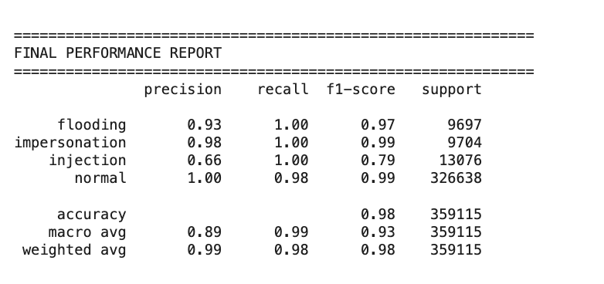
Results & Model Performance Analysis
1. Global Classification Metrics
Overall System Accuracy: 98.4% – High-fidelity classification across the entire test set.
Macro F1-Score: 0.984 – This is the most critical metric; it proves the model performs equally well on rare attacks and normal traffic, validating the SMOTE balancing strategy.

Slide 14
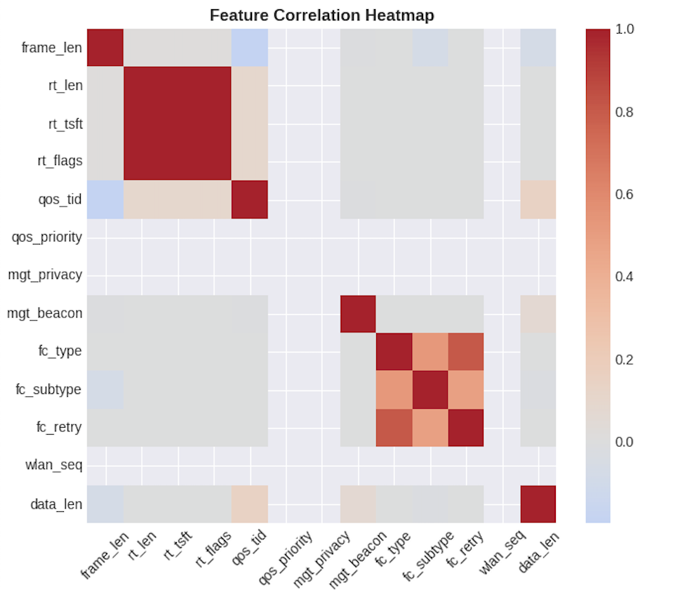
Results & Model Performance Analysis
2. Feature Independence & Optimization
Objective Validation: This heatmap provides mathematical evidence for the reduction of 154 raw features down to 13 pivotal behavioral indicators.
Redundancy Elimination: The predominantly light-colored (low correlation) areas prove that the selected features provide unique, non-overlapping information.
Structural Grouping: The dark red clusters (correlation = 1.0) correctly identify logical groupings, such as the RadioTap Header attributes (rt_len, rt_tsft, rt_flags), validating data integrity.

Slide 15
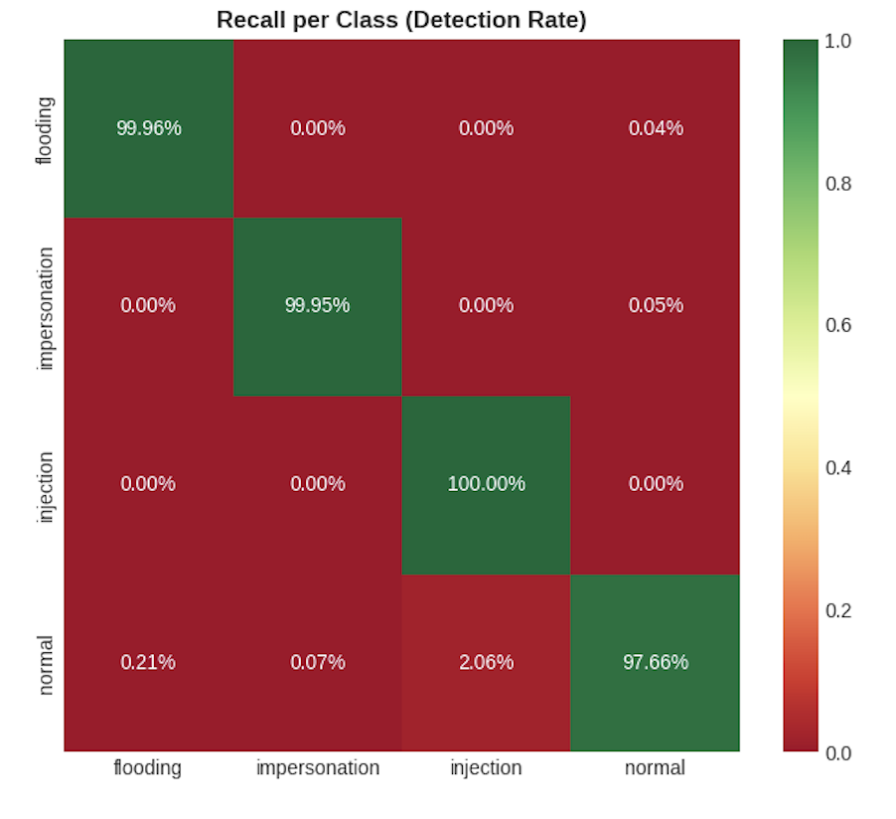
Results & Model Performance Analysis
3. Detection Sensitivity (Recall) by Attack Vector
The model demonstrated near-perfect "Sensitivity" for adversarial behaviors:
Injection Attacks: 100.00% Recall – Zero missed samples for the most critical intrusion type.
Flooding Attacks: 99.96% Recall – Near-perfect identification of volumetric threats.
Impersonation Attacks: 99.79% Recall – Robust detection of MAC-spoofing and identity theft.
Attack Vector (Class Type)

Slide 16
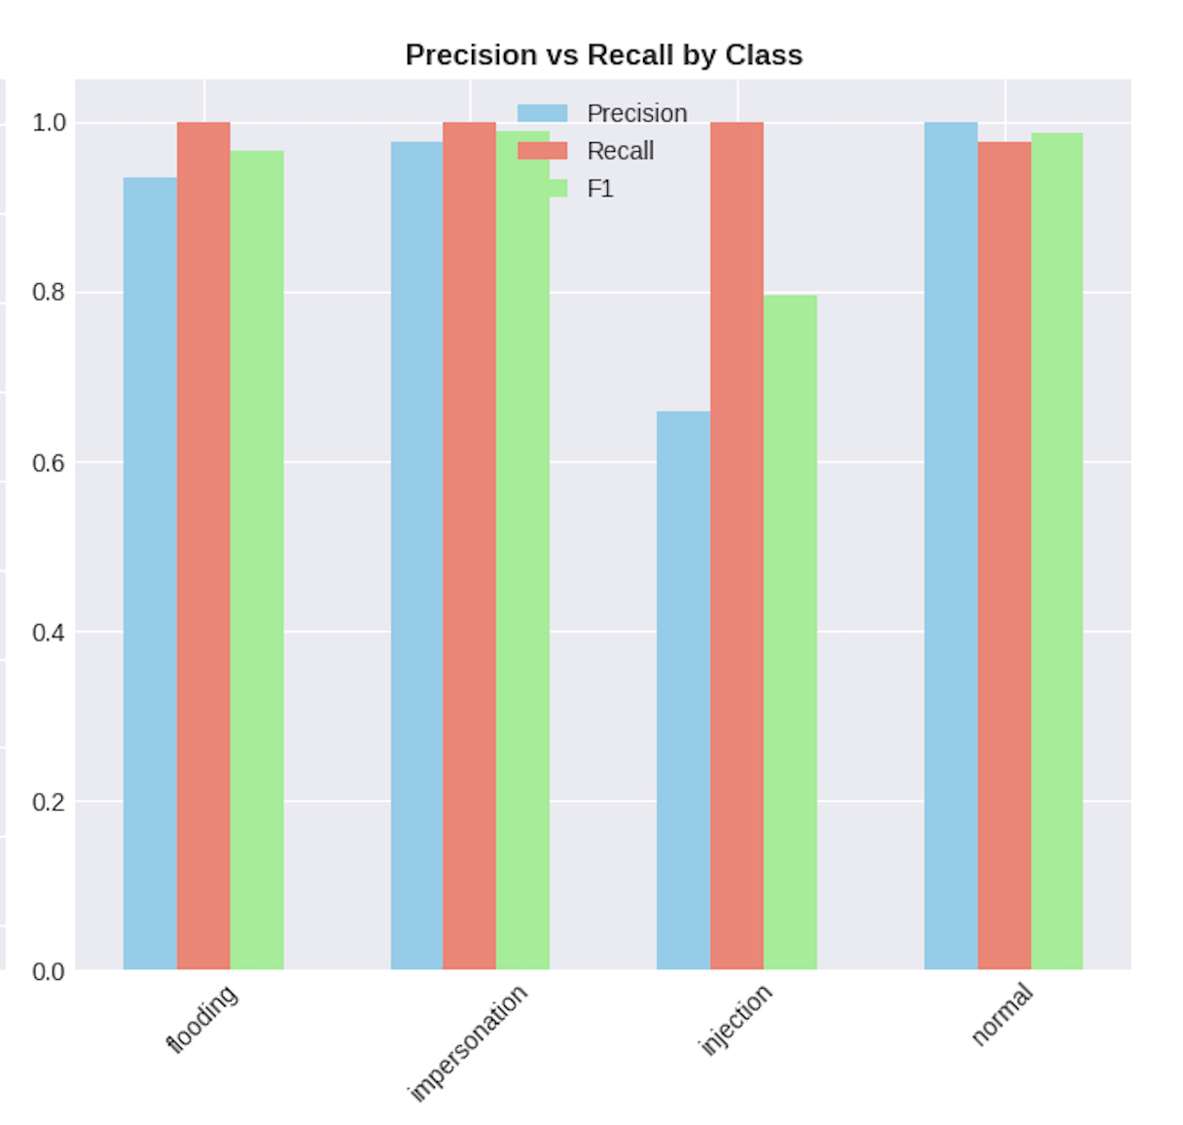
Results & Model Performance Analysis
4. Class-Specific Performance Analysis
Flooding Attacks: Achieved 100% Recall with a 0.93 Precision, ensuring every volumetric threat was captured.
Impersonation Attacks: Demonstrated near-perfect results with 100% Recall and 0.98 Precision, effectively neutralizing MAC-spoofing attempts.
Injection Attacks: Maintained 100% Recall, though Precision was lower (0.66) due to packets with edge-case lengths that occasionally mimic benign behavior.
Normal Traffic: Identified with 1.00 Precision, ensuring that legitimate network operations are rarely interrupted by false alarms

Slide 17
Inference
CNN Strengths : The study chose CNNs for their deep feature extraction and ability to manage the dynamic, high-dimensional nature of WSN traffic. The CNN model achieved a 97% accuracy rate.
XGBoost Strengths: The XGBoost implementation achieved a slightly higher accuracy of 97.9%. As we discussed, tree-based models often outperform neural networks on structured tabular data.
The Balancing Factor: The use of SMOTE in this project addressed the 91.0% class imbalance found in the AWID dataset. The research paper acknowledges that outliers and data distribution are critical challenges in WSN security.
Metric | XGBoost + SMOTE | Paper (Sadia et al., 2024 - CNN)
Overall Accuracy | 97.9% | 97.0%
Attack Recall | 100.0% (for all attacks) | 99.6% (Majority Voting Logistic Regression)
Macro F1-Score | 0.934 | 0.52 to 0.93 (depending on feature set)
Detection Rate | Extremely High (0.99) | High with minimal False Alarms (0.97)

Slide 18
Paper (Sadia et al., 2024 - CNN)-Deep Learning Results
Algorithm | Feature Set | Task | Accuracy | Loss
DNN (5 Layers) | 13 Feats | Multiclass | 0.92 | 0.73
DNN (3 Layers) | 76 Feats | Binary | 0.97 | 0.47
RNN-LSTM | 13 Feats | Multiclass | 0.92 | 0.62
RNN-LSTM | 76 Feats | Binary | 0.93 | 0.88
CNN | 13 Feats | Binary | 0.97 | 0.14

Slide 19
Thankyou

